Slide 1
Activity Diagram
Software Design and Architecture

Slide 2
Activity Diagram
Activity diagrams are for modeling business processes, workflows, data flows, and complex algorithms.
Based on data flow models – a graphical representation (with a Directed Graph) of how data move around an information system.
An activity diagram shows sequential and parallel activities in a process.

Slide 3
Activity diagrams are the object-oriented equivalent of flow charts and data-flow diagrams from structured development
Activity diagrams describe the workflow behavior of a system
Activity diagram illustrates the dynamic nature of a system by modeling the flow of control from activity to activity

Slide 4
When to Use Activity Diagrams ?
To explore the logic of
  a complex operation
  a complex business rule
  a single use case
  several use cases
  a business process
  software processes
Useful for showing workflow and parallel processing

Slide 5
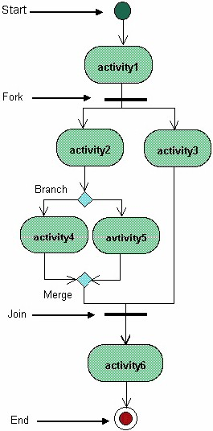
Example

Slide 6
Scenario
Customer places an order
The sales assistant receives the order and processes it.
After successful order processing the order is filled.
The customer makes payment and the order is delivered/shipped to him by sales rep.

Slide 7
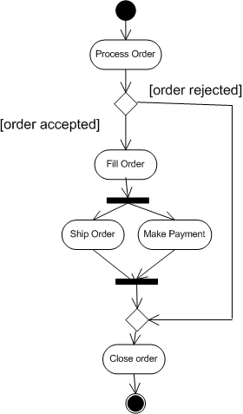
Example 1:

Slide 8


Actions
The fundamental unit of executable functionality in an activity
The execution of an action represents some transformations or processes in the modeled system (creating objects, setting attribute values, linking objects together, invoking user-defined behaviours, etc.)
Description of the action behaviour

Slide 9

Control nodes – initial nodes
In an activity the flow starts in initial nodes, that return the control immediately along their outgoing edges

Slide 10
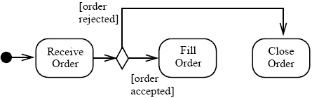
Control nodes – decision nodes
Route the flow to one of the outgoing edges

Slide 11
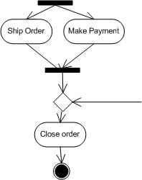
Control nodes – merge nodes
Bring together multiple alternate flows
All controls and data arriving at a merge node are immediately passed to the outgoing edge

Slide 12

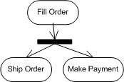
Control nodes – fork nodes
Fork nodes split flows into multiple concurrent flows

Slide 13

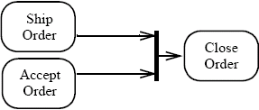
Control nodes – join nodes
Join nodes synchronize multiple flows

Slide 14
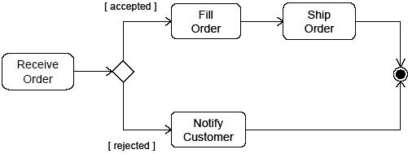

Control nodes – final nodes
Final node:
  the activity is terminated when the first token arrives

Slide 15
Swim Lanes
Partitions, also called swimlanes, indicate who/what is performing the activities.

Slide 16
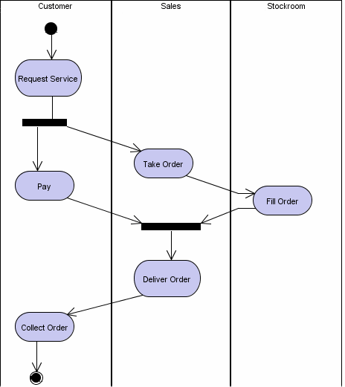
Example-2

